Slide 1
The Cyber Kid’s Guide
To Staying Safe Online (psst…it’s easy!)
Notes:
[INTRODUCE YOURSELF – tell the students your name, your position and why you are qualified to give this information. Thank them for attending. Our overall theme for this entire presentation is “It’s Easy to Stay Safe Online.” You are passionate about cybersecurity and you are here to help!]

Slide 2
What is Cybersecurity?
It is how you can stay safe online!
  By coming here, you’re already most of the way there. You can start adopting these behaviors in less time than this presentation.
Notes:
Let’s talk about security. What are some things you keep secure? Your bookbag. Your locker. Your parents might lock the car doors while they are driving. They lock the house when they leave.
Did you know you should also stay secure online? You can take some easy steps to stay safe when you’re using a computer, phone, gaming console, or tablet. Even as a kid, you can start some habits to have good cybersecurity. I’m going to give you some simple and easy tips for staying safe online. You can start doing these today, and still have time to learn a new Tik Tok dance today.
I will focus on 4 Core Behaviors that I want you to remember:
Create strong passwords
Protect yourself with face IDs or fingerprints
Keep your tech updated
Understand phishing
By coming to my presentation, you are already most of the way there. The biggest hurdle is just taking the action to get started. I promise you, these behaviors do not take much time and you can do them all for free. You’ll have to repeat these behaviors over time, but once you get started, you can find an easy rhythm that works for you.

Slide 3

Let’s see what you know!
It is how you can stay safe online!
Notes:
[Do a quick poll of the audience:
Do they know what makes for a strong password (unique, long, complex)?
How do kids in the audience store their passwords? Do you know how your parents store their passwords?
Do they have automatic software updates turned on for their computers and other devices?
Do they know what phishing is?
With this information, you can know what behaviors to focus on and if you need to pivot.]

Slide 4
Know Your Core 4!
1
2
3
4
Create long and complex passwords for each account
Use 2x authentication when available
Update your tech
Identify and report phishing
Notes:
You can protect yourself by adopting just 4 behaviors. I find these 4 behaviors to be the most important for staying safe online for most people, even kids. Luckily, once you know what they are, they are easy to adopt and repeat. And if any of this sounds confusing, I will have resources for you and you can work with your family members to stay safe online.
The Core 4 behaviors are:
Protect each of your accounts with a strong password – a strong password is special to the account, at least 12 characters long, and one that uses letters, numbers, and symbols.
For some accounts, phones, and computers, you can use something called multi-factor authentication. This is a fancy way of saying you can protect them twice. This includes using a face ID scan or fingerprint to unlock your phone, for example.
Keep your technology up to date.
Most hackings start with something called phishing, which is different than what you do at a lake. Phishing is when a hacker sends you a link or email attachment that gives them access to your information. I’ll give you some quick tips for identifying phishing messages and how you can report them!
I’m going to explain all of these habits one by one.

Slide 5
Be a Password Pro!
How to make superhero passwords
Unique
Long
Complex
Passwords can include symbols
? $ # % *
Ask your parents about a password manager!
Notes:
The safety of all your accounts and devices begins with your passwords. Think of your passwords as the door to your online life. You wouldn’t want that door to be unlocked or a door that the wind can push open.
First, you probably know that none of your passwords should be “password” or “1234.”
But here is how you make the strongest passwords – remember 3 words: unique, long, complex.
By unique, I mean each phone, computer, email login, gaming console, and account should have a different password. How are you supposed to remember all these passwords? You can write them down in a special notebook that you keep safe. The best way, though, is a special computer program called a password manager. Password managers are like an online vault that keep your passwords super-safe and even helps you come up with strong passwords. Talk to your parents about researching and downloading a great password manager.
[If you have a favorite password manager, feel free to mention it!]
Again, to come up with strong passwords – just remember 3 words: unique, long, complex.
Next is long. This means every password should be at least 12 characters long. Characters are the letters, numbers, and symbols on a keyboard. A short password, even if it’s complex, is not as good as a longer password.
Finally, all of your long, unique passwords should be complex. What I mean by this is that every password should have a combination of letters, numbers, and special characters like question marks or percent signs. Nowadays, the strongest passwords are not recognizable words, but you can create pretty strong passwords by replacing some letters in words you’ll remember with numbers and symbols – zeros instead of “o’s,” for example.
Have some fun! Use all the little symbols on the keyboard that you never get to use with your homework.

Slide 6
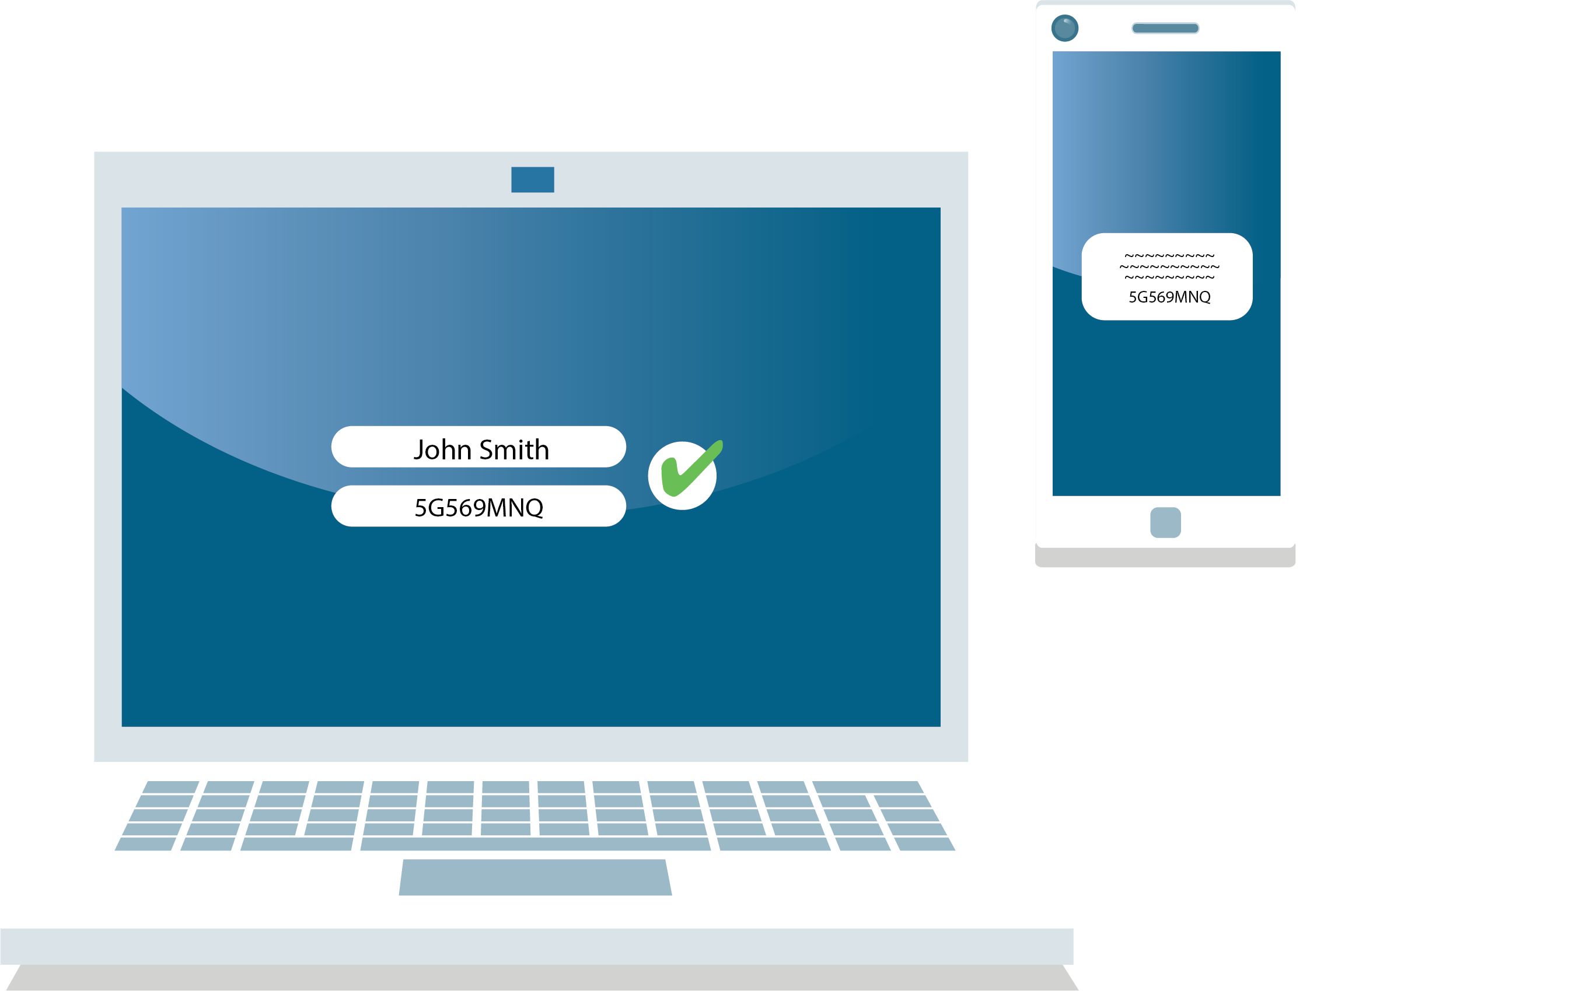
Double Your Online Safety, Double Your Fun!
Use multifactor authentication
  when an account requires you to provide
  2 or more forms of authentication to log in.
Notes:
Some computers, phones, and accounts allow you to protect yourself twice. This is called multifactor authentication or 2-factor authentication. This is a fancy term for when you need to provide 2 ways to sign in. You might already have this set up – if you use Face ID or a fingerprint to unlock your phone, congrats! You are using multifactor authentication.
You can probably use multifactor authentication (or MFA) to protect your most important stuff. Turn on Face ID or fingerprint scans on your phone or computer. See if you can use MFA to protect your email or social media account. Not everything will let you use MFA, but check to see if you can because it keeps your tech very secure.
Think of MFA as a way of building two strong, big walls around your accounts and devices.

Slide 7

Stay up-to-date!
Turn on automatic updates on your tech!
Notes:
Do you all like to stay up to date with trends? What’s going on on Instagram? What’s the best new music? What are the trendiest clothes to wear? Even if you don’t love all the new stuff coming out, you probably know what is up to date.
Did you know you can keep your technology up to date? The people who make computers, phones, games, and apps release updates all the time. While it might take some time to load up, these updates fix any issues that have been happening and these updates keep you safe.
Before doing any updates, save and close any files you are working on. Check your technology to see if updates are available. You can also have your parents turn on automatic updates so you’ve always got the hippest tech in town.

Slide 8
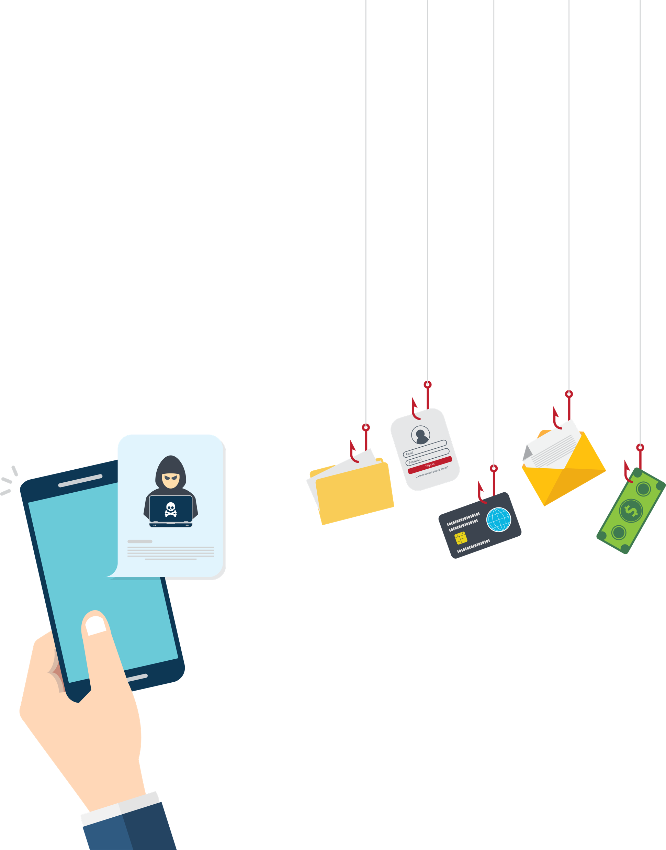
What is Phishing?
Phishing, not fishing!
Notes:
Phishing, with a “p-h,” is not something you do at a pond. When a hacker goes phishing, they are trying to get you to take the bait.
Phishing is one of the most common forms of cybersecurity problems. A phishing attack is when a cybercriminal sends an email, text message, or social media message with the hopes that you will click on a malicious link or download a bad attachment. Once the link is clicked or the attachment downloaded, the hacker might be able to install bad programs on your computer or do a bunch of other shady stuff.

Slide 9
Don’t take the bait!
It is how you can stay safe online!
Notes:
If you don’t recognize the person, phone number, or email address sending you a message, don’t click on anything! Talk to a trusted adult and show them the phishing message.
This includes messages that seem entirely out of the blue. Sorry to say, you probably didn’t randomly win $10,000. And you probably don’t owe a bunch of money to the government as a kid.
Criminals want you to act fast and not think, so you don’t realize what you’re clicking.
If you are suspicious, don’t click anything! Don’t click the link to see what it’s all about, don’t download any attachments, don’t even click the “Unsubscribe” button. Just talk to an adult you trust and show them the message. They won’t be mad – in fact, you are doing an awesome thing and letting others know something “phishy” is going on.

Slide 10
Social and safe
✓
✓
✓
✓
Check your settings
Share with care
Once shared, always there
Not everyone is who they say they are
Notes:
Most likely, you’re on some social media network – Snapchat, Tik Tok, Instagram, Discord, Facebook, Twitter…the list seems to grow every year. I’ve got a few general tips for staying safe on social media.
First, always set your settings with an adult. Every time you sign up for a new social media account or download a new app, immediately configure the privacy and security settings to keep yourself private. I’m talking about things like location sharing and how public you want your profile and posts to be. Regularly check these settings along with a trusted adult to make sure they are still configured to your comfort.
Be cautious about how much personal information you provide on social networking sites. The more information you post, the easier it may be for a hacker or someone else to use that information to steal your identity or access your data.
Finally, be careful with what you share. Protect your reputation on social networks. What you post online stays online. Think twice before posting pictures you wouldn’t want your parents or teachers to see. You might think you can keep your posts away from everybody, but teachers and parents know how to use social media better than you might think! This is true even for apps that supposedly auto-delete posts, like Snap or Instagram Stories, because others can screenshot or screen-record your posts.
Just like in real life, you want to be wary of strangers you don't know online. The truth is that not everyone on the internet is who they say they are! If someone you don't know wants to be friends on social media, talk to an adult. If someone is weirding you out online, there's no shame in having a strong blocking game. You can block people on social media, which means they can't find you or see what you post.

Slide 11

You can stop cyberbullies!
Break the bully cycle
  Be a bullying detective!
  Report it!
Notes:
Cyberbullying is when bullying happens online. It is a very serious issue and many kids today experience some form of cyberbullying at some point in their lives.
Here’s the thing: you can help stop cyberbullying!
First, you can break the bully cycle. If you see bullying happening online, don’t comment, like, or spread the bullying.
You can reach out to the person being bullied and let them know that you support them!
Be a bullying detective! Save images or messages related to the cyberbullying. Take screenshots or screen-record videos. This is evidence of cyberbullying. Show your findings to parents, teachers, or other trusted adults.
Finally, remember to report. The best way to stop cyberbullying is to report it! Report incidents of cyberbullying to your school and your parents. Also, report the situation to the app, game, or website being used. Your school likely has a way for you to report bullying anonymously. Apps, games, and websites have options for anonymous reporting, too. This means no one will know it was you who reported the bullying.

Slide 12
Can you do the Core 4?
  Lack of knowledge
  Takes too much time
  You got nothing to hide
Notes:
[Ask your audience if any of what you’ve talked about sounds too scary, too difficult, or too complicated. Ask them specifically what they don’t understand – try to empower them to get onboard with the Core 4]
Some common issues people have with adopting these behaviors include:
Lack of knowledge: fortunately, that isn’t the case for you because you are attending this presentation! And I have hardcopies of my presentation and resources available for you to take with you!
It takes too much time: Trust me, once you get going, these behaviors do not take much time. Setting up a password manager, or turning on automatic updates for your operating system, takes literally a few minutes.
You think you have nothing to hide and not much money to steal: That might be true, but even pop-up ad issues can slow down your machine, make using the internet a pain, and puts your data at risk. Hopefully, you now know that it’s easy to stay safe online. It’s easy and it’s important!

Slide 13
How fast can you do the Core 4?
1
2
3
4
Strengthen your passwords
Use multifactor authentication on your key accounts
(devices, email, social media)
Set up devices/apps/software to install automatic updates
Reject the phishing bait
Notes:
I challenge you to think about how long it would actually take you to adopt the Core 4 behaviors. You could probably take care of a lot of what I’ve talked about in less than an hour.
Look up the settings of your major accounts and see if they allow you to do multifactor authentication. This could involve a few things – you might have to set up a facial ID or fingerprint scan. None of these will take up much time to set up once you explore these settings.
If you have any passwords that aren’t strong enough, change them! This will not take long. Have a trusted adult help you set up a password manager and you can store all your passwords in that program.
Go through your tech and download the latest updates. The download and installation process might take some time, but setting up automatic updates does not. You can often set up updates to take place when you aren’t using your device, like while you are sleeping.
Finally, I hope that you don’t have a lot of identifying and reporting phishing messages to do when you get home, but now you know what to look for. Take a handful of seconds before acting when you get any message – if it appears to be a phishing attempt, report and delete it.
I bet that, in the time it took you to listen to my presentation, you can be well, well on your way to staying safe online!

Slide 14
Start small!
You don’t have to do everything at once
Notes:
Of course, this might sound like a lot. I would hate for you to feel intimidated and not take any action.
You can start small. Change one password so it is stronger, for example. See what it is like to create a strong password.
Or check for updates on one device and install them.
See if you can put MFA on for your main computer or smartphone, like using a fingerprint or face ID.
Take it easy – with time, you’ll have awesome skills with these Core 4!

Slide 15
You have the power to stay safe online!
Kids can do cybersecurity!
  There is no reason to be scared, but it's good to be a
  little suspicious!
  For more info and coverage of cybersecurity topics,
  check out staysafeonline.org!
Notes:
In conclusion, I want all of you to understand that even as a teenager, you have the power to stay safe online! These behaviors are easy, trust me. And you can start small if you feel intimidated.
Your data and identity are important. With a few simple steps, a few minutes, and a little bit of effort, you can protect yourself online for years to come.
Please let me know if you have any questions. For more information, check out staysafeonline.org!

