Slide 1
Staying Safe Online?
It’s Easy!
Notes:
[INTRODUCE YOURSELF – tell the students your name, your position and why you are qualified to give this information. Thank them for attending. Our overall theme for this entire presentation is “It’s Easy to Stay Safe Online.” You are passionate about cybersecurity and you are here to help!]

Slide 2
Staying secure is not as hard as you might think
Focus on the Core 4
  By coming here, you’re already most of the way there. You can start adopting these behaviors in less time than this presentation.
Notes:
Staying safe online is not as hard as you might think – I’m going to go over 4 key behaviors that are easy to adopt. Even teenagers can adapt these habits – your devices, email accounts, social media accounts, gaming avatars, homework, all of it is worth keeping secure. With the Core 4, you can lock down your online accounts, keep your data very safe, and still have time to learn a new Tik Tok dance today.
The core 4 behaviors are:
Use multi-factor authentication
Use strong passwords and a password managers
Keep your software updated
Identify phishing attempts
By coming to my presentation, you are already most of the way there. The biggest hurdle is just taking the action to get started. I promise you, these behaviors do not take much time and you can do them all for free. You’ll have to repeat these behaviors over time, but once you get started, you can find an easy rhythm that works for you.
You can adopt these core 4 behaviors in less time than it will take me to do this presentation!

Slide 3
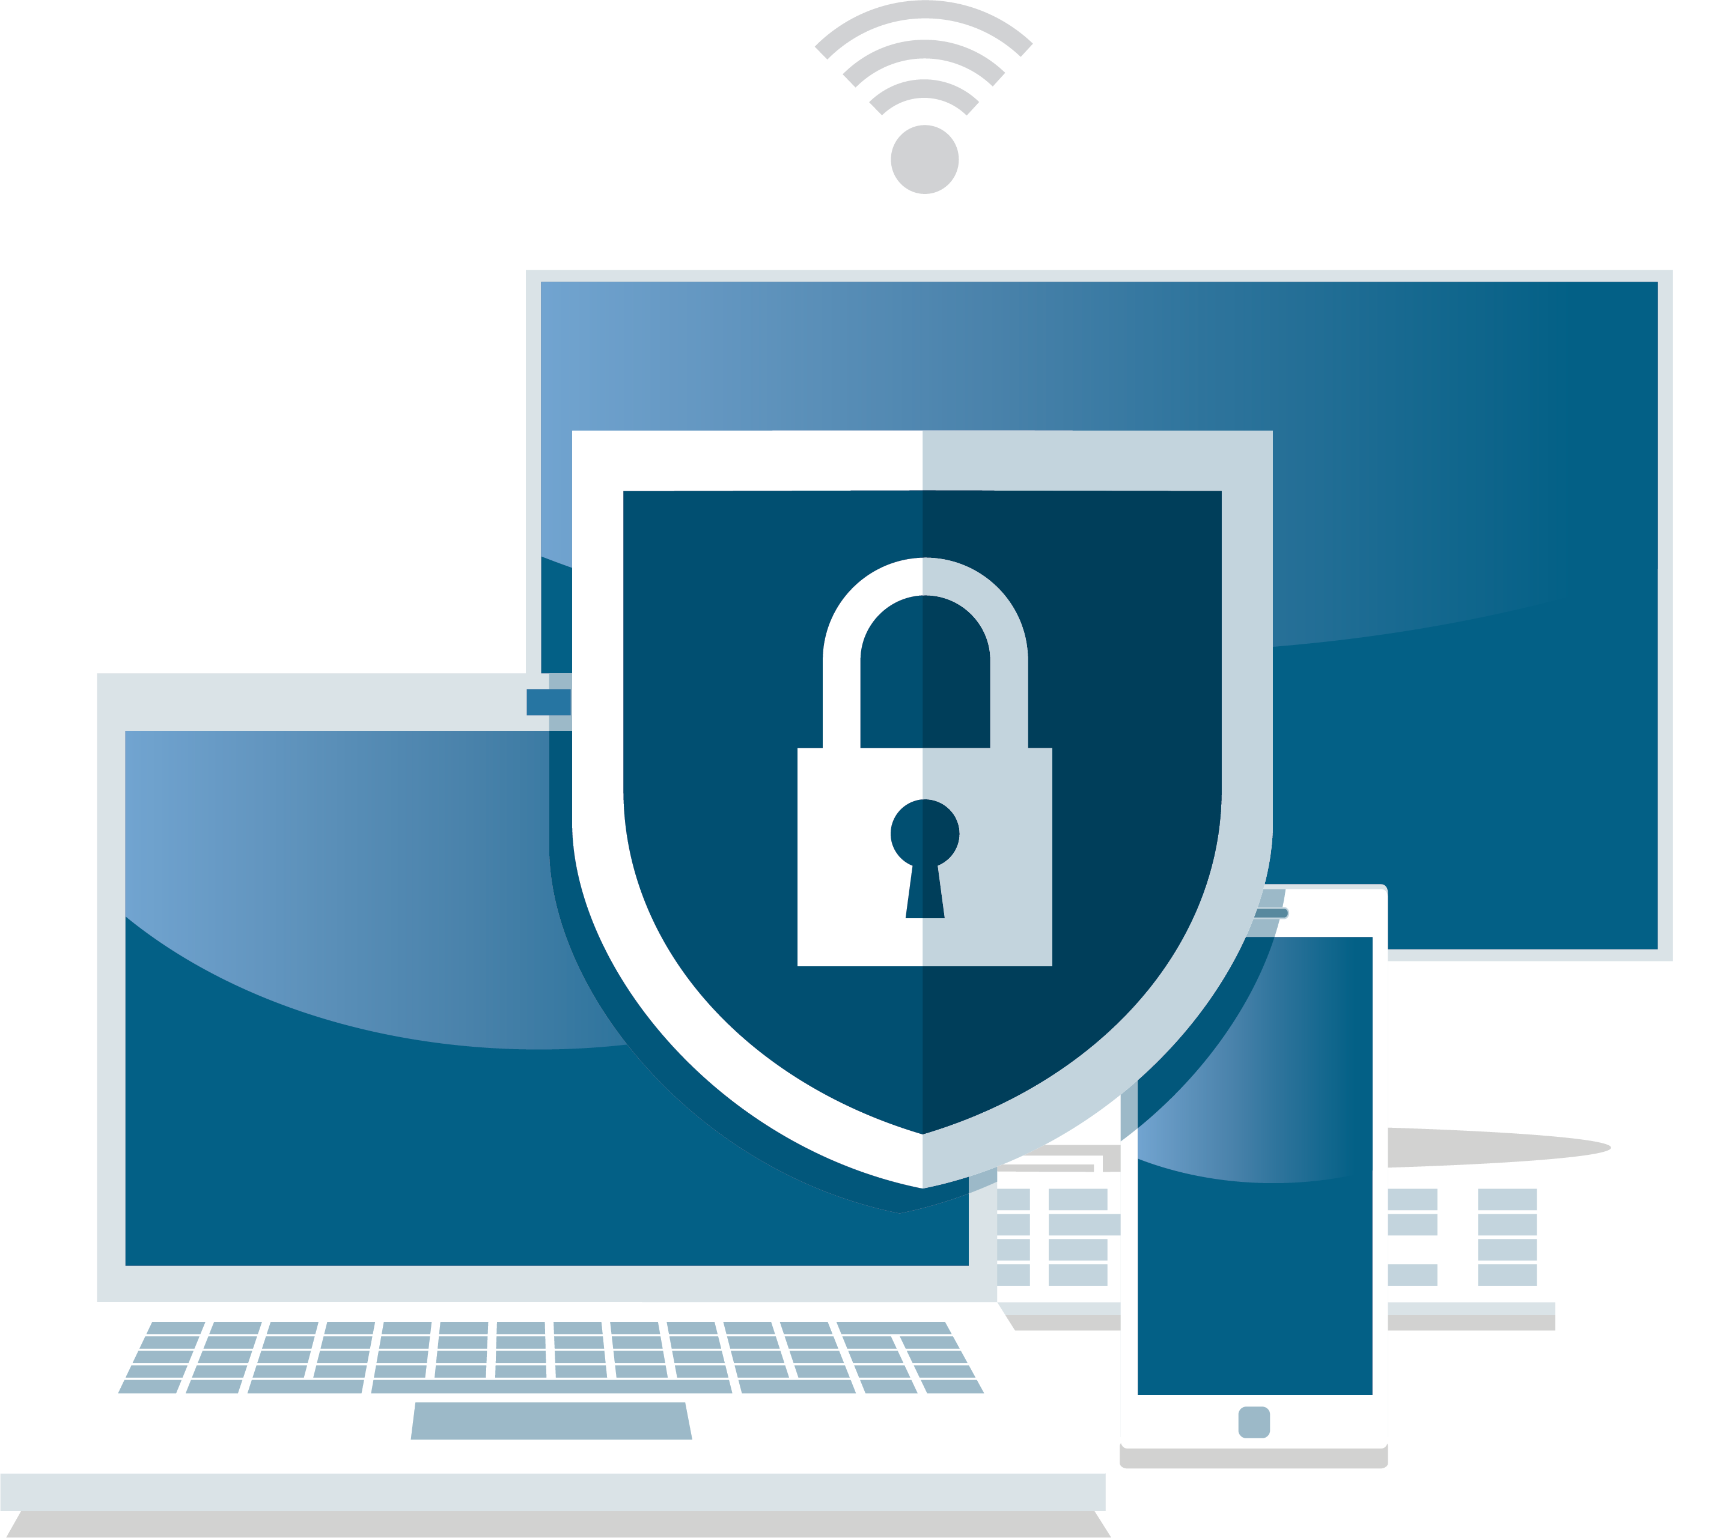
Let me know what you know
Notes:
[Do a quick poll of the audience:
Do they know what makes for a strong password (unique, long, complex)?
Does anyone use a password manager? How do their parents keep their passwords secure?
Do they have automatic software updates turned on for their computers and other devices?
Do they know what phishing is?
With this information, you can know what behaviors to focus on and if you need to pivot.]

Slide 4
Don’t be scared!
You have the power to defeat cybercriminals, and getting started is easy!
Notes:
There’s no reason to be scared or intimidated by cybersecurity.
- By doing a few simple behaviors, you can really reduce the chances that hackers invade your accounts or devices.
- Cybersecurity is a serious issue, even for kids and teens, but it’s easy to get started.
- At the end of the day, I hope that you understand that you have the power to protect yourself!

Slide 5

Staying safe online doesn’t take much time or cost money
You can begin protecting your accounts in minutes.
Notes:
The truth is, staying safe online can be easy and fast – like literally a few minutes. You might have to set up a password manager and multi-factor authentication, but that process is not time-consuming.
I’ve found that the biggest hurdle is that many people feel sort of powerless when it comes to cybersecurity issues. Yes, even young people who had a smartphone in their crib. But you can take control of your security and data. You can even get started slow by creating a few passwords with a password manager, for example, and then use it more with time.
I’m giving you some tips that won’t require fancy, expensive anti-virus software or take an afternoon chatting with tech support to implement. I’m talking a few behaviors that require maybe 5 or 10 minutes of effort and that you just repeat with time.

Slide 6
Know Your Core 4!
1
2
3
4
Use multifactor authenticationwhen available
Create unique, long and complex passwords for each account, and use a password manager
Update your software
Identify and report phishing
Notes:
You can protect yourself from cybercriminals by adopting just 4 behaviors. I find these 4 behaviors to be the most important for staying safe online for most people. Luckily, once you know what they are, they are easy to adopt and repeat. Many of these behaviors can be made automatic.
The Core 4 behaviors are:
Use multi-factor authentication when available to secure accounts. This is when an account is requires multiple pieces of information for you to log in, like a fingerprint or approving a log-in attempt on an app.
Protect each of your accounts with a strong password – a strong password is unique to the account, at least 12 characters long, and one that uses letters, numbers and symbols. A password manager can help you create strong passwords and store them in an encrypted vault.
Keep your software updated on all of your devices and computers. It’s best to just turn on automatic updates so you don’t have to check regularly. Updating your software ensures you have up-to-date protection.
Most cyberattacks start with phishing, where a hacker sends you a link or email attachment that gives them access to your information. I’ll give you some quick tips for identifying phishing messages and how you can report them!

Slide 7
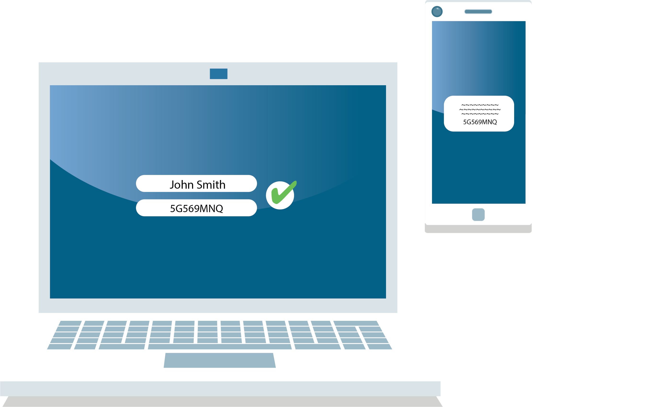
Use multifactor authentication
When an account requires you to provide
2 or more forms of authentication to log in.
Notes:
Multifactor authentication, or MFA, is sometimes called 2-step authentication. This is when an account requires you to provide 2 or more forms of authentication to log in. Typically, you enter your username and password on the log in page, and then you are prompted to authenticate the log-in attempt some other way.
This authentication can take several forms:
A facial ID
A fingerprint
Entering a code from a text message, phone call, or email
Approving the log-in attempt using an app. Google Authenticator and Duo are common examples of MFA apps.
According to surveys, about half of people have never heard of MFA. As of today, all of you are in the half that knows about it!
Of those that know about it, we find that some 90% keep using it. That’s because once you set up MFA, it is very easy to use. Many universities, colleges, and workplaces require MFA use, so you should start getting comfortable with it now.
Not every account will allow for MFA, but check to see if you can turn it on, especially for important accounts like email or social media. MFA puts a whole other level of protection on your accounts beyond your password.

Slide 8
What is a strong password?
3 Elements of Strength
  Unique
  Long
  Complex
If you are worried an account was compromised, change the password ASAP.
Notes:
The safety of all your accounts and devices begins with your passwords. You probably know that none of your passwords should be “password” or “1234.” But that’s the lowest of bars, and today’s cybercriminals are way more sophisticated. Consider this – bots and software programs are now common tools for trying to crack a password, and these programs can try out every word in the dictionary in a matter of minutes. Using your pet’s name or the town you grew up in just isn’t very secure.
But coming up with strong passwords isn’t hard – just remember 3 words: unique, long, complex.
Yes, you really, really shouldn’t reuse passwords. If you use the same password for your bank account and some game on your phone you play once, if the game developer gets hacked, your bank account is at risk. Every account should have its own unique password. Now how the heck are you supposed to remember all these passwords? You aren’t. Use a password manager – I’ll get to that next.
Next, every password should be at least 12 characters long. A short password, even if it’s complex, is not as good as a longer password.
Finally, all of your long, unique passwords should be complex. What I mean by this is that every password should have a combination of letters, numbers, and special characters like question marks or percent signs. Nowadays, the strongest passwords are not recognizable words, but you can create pretty strong passwords by replacing some letters in words you’ll remember with numbers and symbols – zeros instead of “o’s,” for example.
Many web browsers and devices include password management systems that will auto-create and save strong passwords for you. It isn’t necessary to decipher your passwords typed in your Notes app.
And if you are ever alerted to a possible account breach, or you suspect an account is compromised, change the account’s password first thing.
If all this seems a bit overwhelming, don’t panic! I’ll explain how you can manage all your passwords easily!

Slide 9
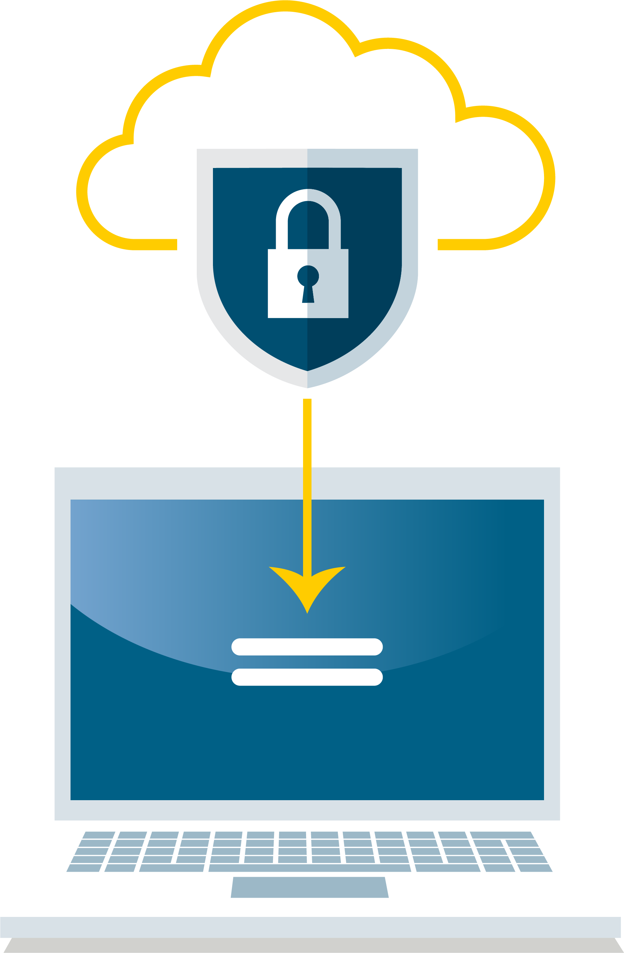
Use a password manager!
Nowadays, you don’t need to remember your passwords!
Notes:
One of the most important things you can do after my presentation is to download a password manager! With a password manager, you can create and save strong passwords in seconds. Many password managers can be set up to work across devices, too.
There are many free, safe and respected password manager programs out there. You can see look up lists of options from outlets like Consumer Reports or staysafeonline.org. [If there is a password manager program you prefer, feel free to mention it!]
Many smartphones, computers and web browsers also come with a form of a password manager. These settings can generate and store strong passwords for you.
But what if someone finds out the password to my password manager, you ask? Many options require MFA, so they are kept safe in multiple ways. At the end of the day, a password manager is the best solution, because, unless you have a near-superhuman memory, it is impossible to remember unique, strong passwords for each of your hundreds of accounts.

Slide 10

Update your software
Turn on automatic updates
Notes:
Software is dynamic. What I mean by this is that it is always changing – developers discover and fix bugs, platforms add more features. With every piece of software, a quiet arms race gets going – hackers try to find holes to exploit, while developers try to beat back any hacking attempt while pouring over the code for potential cybersecurity gaps.
How do you make sure your software has the strongest protection? Keep it updated.
This includes your computer operating system, like Windows, MacOS, or iOS or Android for mobile devices. It also includes all the software on your computer and apps on your phone or tablet.
Yes, that sounds like a lot of updating. How will you find the time to ever use your machines if you’re always updating? Solution: you can set your software to update automatically. In some cases, your system will allow you to update outside of when you normally use your computer. While you are fast asleep, your computer can be fortifying itself against the latest hacking threats!

Slide 11

Do a device audit
Every so often, get rid of apps and software you don’t use
Notes:
It is also wise to regularly audit the software on your computers and apps on your devices every few months. That piano lesson app you downloaded and used once two years ago? Not only is it taking up space on your phone, it could be collecting your data. Worse, it could present a door to cybercriminals to the rest of your device or accounts. Your device, your attention, is valuable real estate! It deserves to be kept fresh and efficient.

Slide 12
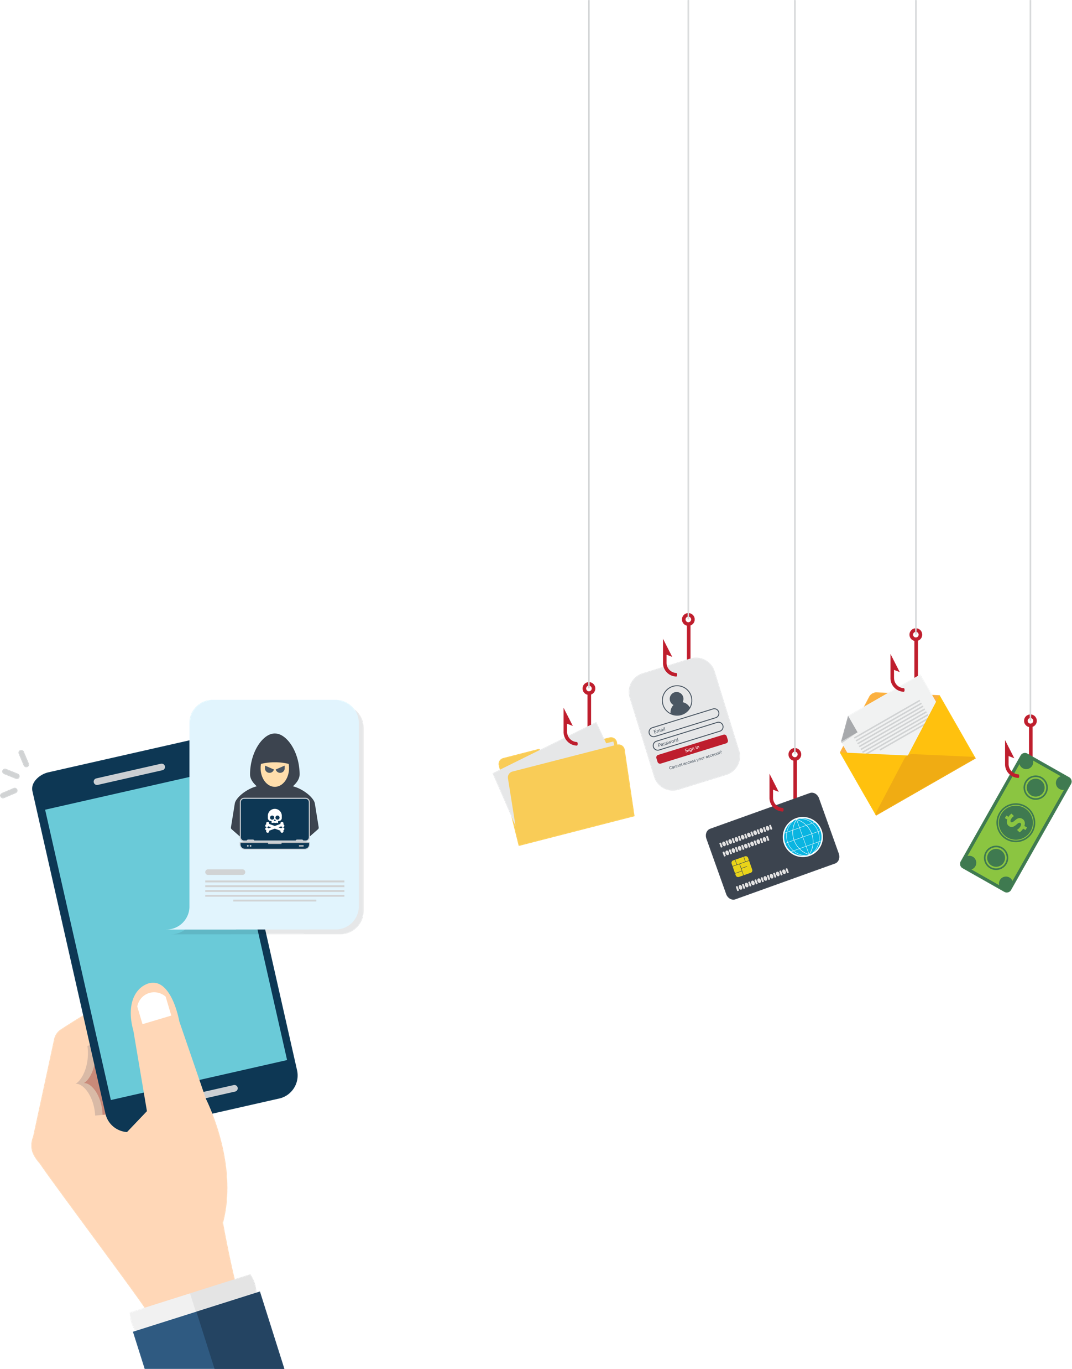
Phishing: Don’t take the bait
Look out for anything too good to be true, urgent, or suspicious.
  Don’t click anything
  – seriously, anything.
Notes:
Phishing is one of the most common forms of cybersecurity breaches. A phishing attack is when a cybercriminal sends an email, text message, or social media message with the hopes that the recipient will click on a malicious link or download a bad attachment. Once the link is clicked or the attachment downloaded, the hacker might be able to install malware on your computer or do a bunch of other shady stuff.
You might have heard of phishing before, but it is good to remember that cybercriminals are trying every day to improve their disguises.
Any communication from an unknown sender should perk your ears up, as well as any message that seems entirely out of the blue. No, you probably did not win a diamond necklace if you never entered a contest for it. You probably aren’t being sued if you are 14.
Look out for messages that seem either too good to be true, or on the flip side, too awful to be true. Phishers want to create a sense of urgency to send you into a fit of ecstasy or panic so you don’t think about what you’re clicking.
Typos and grammatical errors, vague greetings, and short messages are all hallmarks of a phishing message. Look at the email address of the sender – it might be a spoof of a legit website, like Goggle instead of Google.
If you are suspicious, don’t click anything! Don’t click the link to see what it’s all about, don’t download any attachments, don’t even click the “Unsubscribe” button.
For every email, text, or DM you get from an unfamiliar sender, take a few seconds – like, literally count to 4 or 5 – and do a gut-check on if it is a phishing attempt or not. Is it making you feel confused, scared, or like you have to act fast?
If you are on the fence, don’t click anything. Open another browser tab and use a search engine to look up the sender’s email address or the subject of the message. You might find more information about whether it is a well-known scam or not. Regardless, if your gut is telling you something is off, don’t click.

Slide 13

Report phishing attempts
Notes:
One way to help stop cybercriminals is to not just delete phishing emails, but to report the email as well.
Many email clients and social media platforms let you report phishing attempts with the click of a button – by doing this, you can help investigators shut down hackers.
You can also block the email account, social media account or phone number from contacting you in the future.
No matter what, though, don’t click anything in the phishing message itself – again, not even if there is a “unsubscribe” button in the email.
After reporting it, delete the message. If you are unable to report the message, delete the message.

Slide 14
More ways to stay safe online
Think before you click
Check your settings
Shop safe!
Notes:
Going beyond our Core 4 behaviors, I recommend that you just generally have an attitude of thinking before clicking. By getting us into a passive routine of scrolling and clicking, cybercriminals and malware can take advantage.
Links in email, tweets, texts, posts, social media messages and online advertising are the easiest way for a bad actor to get your sensitive information. Be wary of clicking on links or downloading anything that comes from a stranger or that you were not expecting.
Along with keeping your software updated, don’t be afraid to look over your settings.
Every time you sign up for a new account, download a new app, or get a new device, immediately configure the privacy and security settings to your comfort level for information sharing. Regularly check these settings to make sure they are still configured to your comfort.
I’m sure for many of you, online shopping is simply “shopping.” To keep your payment info safe and avoid scams, watch out for fake e-commerce sites. Prior to making a purchase, read customer reviews of the merchant. Check trusted sources, like the Better Business Bureau, as well as online platforms. In addition, see if the store has a physical location and any customer service information. If you still have doubts, call the merchant to confirm that they are legitimate.

Slide 15
Social and safe
✓
✓
✓
✓
Check your settings
Share with care
Once shared, always there
Not everyone is who they say they are
Notes:
Most likely, you’re on some social media network – Snapchat, Tik Tok, Instagram, Reddit, Facebook, Twitter…the list seems to grow every year. I’ve got a few general tips for staying safe on social media.
First, always check your settings. Feel free to check your settings right now! Every time you sign up for a new social media account or download a new app, immediately configure the privacy and security settings to your comfort level for information sharing. I’m talking about things like location sharing and how public you want your profile and posts to be. Regularly check these settings to make sure they are still configured to your comfort.
Be cautious about how much personal information you provide on social networking sites. The more information you post, the easier it may be for a hacker or someone else to use that information to steal your identity, access your data or commit other crimes such as stalking. You don’t want to become the face of some random finsta! You don’t need to tell some random account what the name of your first pet was!
Finally, be careful with what you share. Protect your reputation on social networks. What you post online stays online. Think twice before posting pictures you wouldn’t want your parents or future employers to see. Some recent research finds that 70% of job recruiters rejected candidates based on information they found online. This is true even for apps that supposedly auto-delete posts, like Snap or Instagram Stories, because others can screenshot or screen-record your posts.
[We have a resource that lists how you can configure privacy settings for dozens of websites you can share with the audience: https://staysafeonline.org/resources/manage-your-privacy-settings/]

Slide 16

Be wary of Public Wifi
Don’t log into key accounts
  Better yet, use a VPN or personal hot spot
Notes:
By their very nature, public wireless networks and hotspots are not secure, which means that anyone could potentially see what you are doing on your laptop or smartphone while you are connected to them.
Limit what you do on public Wi-Fi, and avoid logging in to key accounts like email and banking.
I recommend using a service known as a virtual private network (VPN) if you have to use public wifi. Also, a personal or mobile hotspot provides a more secure connection than public wifi.

Slide 17
What problems do people have with adopting Core 4?
Lack of knowledge
Takes too much time
You got nothing to hide
Notes:
[Ask your audience if any of what you’ve talked about sounds too scary, too difficult, or too complicated. Ask them specifically what they don’t understand – try to empower them to get onboard with the Core 4]
Some common issues people have with adopting these behaviors include:
Lack of knowledge: fortunately, that isn’t the case for you because you are attending this extremely informative presentation! And I have hardcopies of my presentation and resources available for you to take with you!
It takes too much time: Trust me, once you get going, these behaviors do not take much time. Even downloading or setting up a password manager, or turning on automatic updates for your operating system, takes literally a few minutes.
You think you have nothing to hide and not much money to steal: Sure, hackers might not be able to blackmail you with evidence that you are a criminal mastermind and you might not have millions sitting in crypto, but even simple malware issues can slow down your machine, make using the internet a pain and puts your data at risk. Hopefully, you now know that it’s easy to stay safe online. It’s easy and it’s important!

Slide 18
How fast can you do the Core 4?
1
2
3
4
Put MFA on your key accounts (devices, email, banking, social media, work)
Download a password manager and strengthen your passwords
Set up devices/apps/
software to install automatic updates
Reject the phishing bait
Notes:
I challenge you to think about how long it would actually take you to adopt the Core 4 behaviors. You could probably take care of a lot of what I’ve talked about in less than an hour.
Look up the settings of your major accounts and see if they allow you to do multifactor authentication. This could involve a few things – you might have to set up a facial ID or fingerprint scan, download a specific MFA app or provide the service with your email address or phone number. None of these will take up much time to set up once you explore these settings.
Next, download a password manager! This takes mere moments, and there might be one already set up through your device or web browser. Once you have a manager, it will automatically ask you to save passwords as you go to the log in page of various accounts. You can use it to generate strong, unique passwords for new accounts or create better passwords for your existing ones. Many password programs will let you know if any of your passwords are weak or have been compromised in a breach.
Go through your devices and systems and download the latest updates. The download and installation process might take some time, but setting up automatic updates does not. You can often set up updates to take place at night or whenever you aren’t using your device.
Finally, I hope that you don’t have a lot of identifying and reporting phishing attempts to do when you get home, but now you know what to look for. Take a handful of seconds before acting when you get an email – if it appears to be a phishing attempt, report and delete it.
I bet that, in the time it took you to listen to my presentation, you can be well, well on your way to staying safe online!

Slide 19
Start small!
You don’t have to do everything at once
Notes:
Of course, this might sound like a lot. I would hate for you to feel intimidated and not take any action.
You can start small. Download a password manager, for example. See how it works. Add a few passwords for a few accounts. Over time, your passwords will get stronger and you will have a place to store them.
Or check for updates on one device and install them.
See if you can put MFA on for your main computer or smartphone, like using a fingerprint or face ID.
Take it easy – with time, you’ll have awesome skills with these Core 4!

Slide 20
You have the power to stay safe online!
There is no reason to be scared!
  For more info and coverage of cybersecurity topics, check out staysafeonline.org!
Notes:
In conclusion, I want all of you to understand that even as a teenager, you have the power to stay safe online! These behaviors are easy, trust me. And you can start small if you feel intimidated.
Your data and identity are important. Companies pay billions of dollars for data. Your email messages, surfing habits, texts and other online habits are valuable! With a few simple steps, a few minutes, and a little bit of targeted energy, you can protect yourself.
Please let me know if you have any questions. For more information, check out staysafeonline.org!

